Slide 1
Cover Letter

Slide 2
What is a Cover Letter?
1. A cover letter is a job application document where you address-
a potential employer and
build your case
for why you are the best candidate for the job.
2. Although many applicants dismiss cover letters as a waste of time, 83% of recruiters said cover letters are important when applying for a job.

Slide 3
Points to Remember
Cover letter creates a compelling story of your career.
A well-written cover letter can make you an unforgettable applicant.
The cover letter should mention-
why you are interested in the position and
feature accomplishments demonstrating your qualifications.

Slide 4
Anatomy of a Cover Letter
Header
Greeting
Opening Paragraph
Body Paragraphs
Closing Paragraph

Slide 5
Step 1 Structure your Header
Your cover letter’s header should include:
Your name
Location (city and state)
Phone number
Email
The date of when you plan to send the letter
Name and job title of the hiring manager
Name and address of the company you are applying to
Some optional information you can include in your cover letter’s header is:
Your current job title
Your LinkedIn page
Links to your professional social media accounts

Slide 6
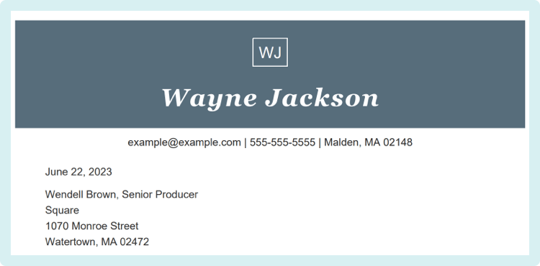
Step 1 Sample

Slide 7
Step 2 Address your Recruiter
Addressing the hiring manager by name is a great way to show your professionalism and attention to detail.
A big no-no in cover letter writing is addressing the recipient with “Dear Sir or Madam.”
Good cover letter greetings examples
Dear hiring manager,
Dear [XYZ Company] team,
Dear Customer Acquisition Hiring Manager,

Slide 8
Step 3 Opening Paragraph
A few key elements that should appear in your opening paragraph are:
Your profession/current job title
Your desired position
Your motivation for applying

Slide 9
Step 3 Sample
Good example of cover letter opening paragraph
“After seven years working in marketing as brand manager in multinational companies like P&G and Unilever, I want to use my negotiation and extensive knowledge of retail operations to explore your company’s sales area as sales representative.”
Why this works:
In just one sentence, this applicant informs a potential employer of their years of experience, area of expertise, the role they wish to pursue and the skills to back up their career aspirations.

Slide 10
Step 4 Body Paragraphs
Your cover letter’s body can consist of one or two paragraphs where you offer more context to your career accomplishments.
You should not repeat everything you mentioned in your resume verbatim.

Slide 11
Step 4 Sample
Body paragraph example focused on career accomplishments
“In my previous teaching role, I carved out 10-minute slots in my senior class to do SAT prep testing, resulting in having the district’s highest SAT score average in English. My dedication to my student’s needs has always been my priority, and students responded with increased participation in the portion of the class allotted for the syllabus topics. After being named Teacher of the Year, I organized a continuing education and mentorship program for newly graduated teachers in the school district.”

Slide 12
Body paragraph example focused on skill set
“Throughout my career as an accountant, I have acquired skills in various areas of accounting and finance. In my first years, I worked in the public sector, developing budgets between $50,000 and $2 million and ensuring accounting records complied with federal and state regulations. Eventually, I moved to work in private equity firms. I gained firsthand experience in financial analysis in tech investments and monitoring funds’ investments, preparing all financial statements and presenting to investors and stakeholders.”

Slide 13
Body paragraph example focused on career goals
“After graduating from Columbia School of Social Work and working as a volunteer in various non-profit organizations focused on at-risk youth and women’s shelters, I’m eager to put my skills to work as a counselor in the court system. My understanding of vulnerable children’s needs and challenges has inspired me to continue my career supporting children through their caregivers’ or their court proceedings.”

Slide 14
Step 5 Closing Paragraph
Your closing statement should be concise and direct, leaving the reader excited to learn more about you.
Make sure your closer is:
1. One or two sentences long
2. Direct about your eagerness to fill the role
3. Encouraging the reader to set up an interview

Slide 15
Step 5 Sample
Good example of a cover letter closer
“I am eager to discuss how I can contribute to XYZ Company’s mission to impact women professionals in their search for investment opportunities and financial education resources they can trust as Head of Marketing operations. I am available for a call or meeting at your convenience.””
Why this works:
This is a phenomenal closer showing the candidate has researched the company and is passionate about the role. Let yourself stand out without bragging.

Slide 16
Step 6 Signing off
Good cover letter sign-offs
Keep it formal and professional with these signature lines:
Sincerely,
Most sincerely,
Regards,
Best regards,
Kind regards,
Thank you,
Thank you for your consideration,
Respectfully,

